Slide 1



DATATHON 2026
ROUND 1 · IDEA PPT + BASE PROTOTYPE
Team Name: Xploiters
Team Members: Sriram and Vignesh Krishna
Track Chosen: Track 3 · Smart City
Problem Statement Title: Where Should We Fix First?
Product Name: FixFirst – explainable priority engine for city complaints
Notes:
Intro: FixFirst helps city officials decide which locations to review first, with reasons and confidence. Built on the Track 3 datasets (locations, incidents, public complaints).

Slide 2
PROBLEM & TARGET USER
❖ Problem & Target User
Who is the user: municipal operations teams, road & traffic departments and civic-service coordinators, who decide where crews go this week
Pain point: road damage, traffic, flooding, streetlights, drainage and pedestrian safety all compete for one budget and too few field teams
Complaints repeat and severity varies, so no one sees the full picture per location; today the loudest complaint often wins
Why it matters: budgets are tight and complaint volumes are high. The one workflow we fix is the weekly review: where do crews go first?
Evidence from the dataset: 43% of 8,000 complaints are not closed and 29% of 10,000 incidents are unresolved, and complaint volume does not track severity (ρ ≈ 0)
DATATHON 2026 · Round 1 Idea Submission – FixFirst · Team Xploiters
2
Notes:
Who hurts: municipal ops, road/traffic departments and civic-service coordinators. Why now: budgets are tight and complaint volumes are high. Evidence from our own analysis: 3,438 of 8,000 complaints are Open, Assigned or In progress; 2,874 of 10,000 incidents are unresolved; complaint count per location is uncorrelated with incident severity.

Slide 3
SOLUTION & USP
❖ Proposed Solution
FixFirst ranks locations so officials know which to review first, with reasons and confidence
One score per location from joined incidents and complaints: a ranked list officials can defend
❖ USP (Mandatory)
Transparent score: 0–100 score from six visible factors: severity 25%, frequency 20%, recent trend 15%, exposure 15%, backlog 15%, road condition 10%
Reasons + confidence: each location shows why it ranks and what data is missing
Budget what-if: top-N slider plus zone and confidence filters show who makes the cut; Round 2 adds the crew-budget what-if
vs the obvious approach (sort by complaint count): in our data only 3 of its top 50 locations are in the top 50 by severity-weighted incidents
DATATHON 2026 · Round 1 Idea Submission – FixFirst · Team Xploiters
3
Notes:
USP: officials get a ranked list they can defend. The score is a weighted sum of six visible components (percentile-ranked), each location has reasons and a confidence level, and the top-N slider shows who makes the cut; the crew-budget what-if comes in Round 2. Complaint-count comparison: severity-weighted score = sum of Low 1, Medium 2, High 3, Critical 4 per location; top-50 overlap with the complaint-count top 50 is 3.

Slide 4
DATASET & INSIGHTS
❖ Dataset Usage
Tables: locations (1,000), incidents (10,000), public_complaints (8,000), joined on location_id
One feature row per location: incidents, severity, complaints, recency, backlog, closure time, context
Cleaning: parsed timestamps (all 2025); 0 nulls and 0 exact duplicates; 242 repeat complaints (same location + category within 7 days) flagged
Assumption: closure time is recorded even for open items, so models train on closed records only
Insight 1: complaint volume does not track severity (ρ ≈ 0); only 3 of the top 50 locations by complaints are in the top 50 by severity-weighted incidents
Insight 2: big backlog (43% of complaints not closed, 29% of incidents unresolved); no seasonal spike; similar closure time across categories
Insight 3: location context (road type and condition, pedestrian activity, school / hospital, zone) does not explain incident counts or closure time
DATATHON 2026 · Round 1 Idea Submission – FixFirst · Team Xploiters
4
Notes:
All three tables join on location_id; every incident and complaint matches a location. 'Context' = road type, road condition, pedestrian activity, near school/hospital, zone, population density. Findings computed from the three CSVs: no nulls, no exact duplicates; 242 complaints repeat the same location + category within 7 days; resolution_hours / days_to_resolution are filled even for unresolved or open items, so we train on closed records only; monthly counts are flat (chi-square p = 0.30 for incidents); closure time does not differ by category or severity (ANOVA p > 0.17). Location context shows no meaningful link to incident counts, severity, complaint counts or closure time (one borderline p = 0.03 across 48 tests, consistent with chance).

Slide 5
ML MODEL
❖ ML Approach
Built from scratch, APIs declared (Claude, Gemini): the Round 1 priority score is hand-built in pandas; both models below are vibe-coded in NumPy (Round 2)
Resolution-time estimator: ridge regression by gradient descent on 4,562 closed complaints, predicts days to resolve (Round 2)
Incident-volume forecaster: Poisson regression, hand-coded, expected incidents per location next quarter (Round 2)
Features: per-location table: severity load, incidents, density-adjusted complaints, 90-day recency, exposure (school, hospital, footfall), backlog, road condition
Baseline: last-30-day count; category mean. Split: time-aware, train Jan–Sep, test Oct–Dec. Metrics: MAE, Poisson deviance, precision@K
Early check: closure-time MAE 3.29 vs 3.33 days baseline; past incident counts (ρ = 0.04) and location context barely predict outcomes, so the transparent score leads the ranking
DATATHON 2026 · Round 1 Idea Submission – FixFirst · Team Xploiters
5
Notes:
Declared APIs: Claude and Gemini. The Round 1 score is hand-built in pandas; the two models are coded from scratch in NumPy for Round 2. Early check (time-aware split at 1 Oct 2025, 3,414 train / 1,148 test closed complaints): ridge MAE 3.29 days vs about 3.33 baseline. Per-location incident counts Jan-Sep vs Oct-Dec have Spearman 0.04. Re-run these numbers with the final NumPy code before presenting, and report them as they come out.

Slide 6
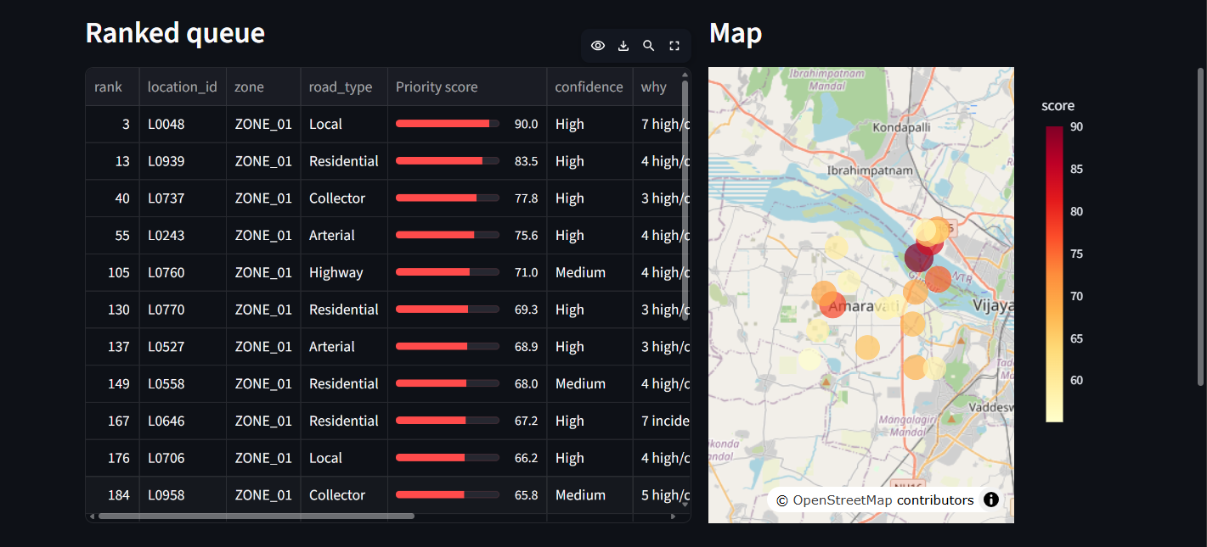
BASE PROTOTYPE & MVP
❖ Base Prototype (Round 1)
Streamlit app: ranked queue with 0–100 score, map, filters and an evidence panel
Each location shows “why it ranks here” (top 3 factors) and what is still missing
❖ MVP for Round 2 (Mandatory)
Must-have features: trend monitor, trained models plugged in, tunable score weights and crew-budget what-if
Demo workflow: 3 CSV tables → clean, join, features → NumPy models → ranked list, map, reasons → send top-N crews, flag data gaps
DATATHON 2026 · Round 1 Idea Submission – FixFirst · Team Xploiters
6
Notes:
Mandatory slide. Round 1 shows the ranked queue, map, filters and evidence panel (built in Streamlit); Round 2 adds trends, trained models, tunable weights and the budget what-if.

Slide 7
TECHNICAL APPROACH
❖ Technical Approach
Technologies: Python, pandas, NumPy, Streamlit, Plotly, GitHub
APIs: Claude and Gemini (external APIs, declared)
Flow: Input → Analysis → Models → Output → Action
Input
3 CSV tables
→
Analysis
Clean, join, build features
→
Models
Score now; NumPy models next
→
Output
Ranked list, map, reasons
→
Action
Send top-N crews, flag data gaps
Every ranked location ships with its reasons, a confidence level and a list of missing information
DATATHON 2026 · Round 1 Idea Submission – FixFirst · Team Xploiters
7
Notes:
Flow: CSVs in, pandas cleaning and joins, NumPy models, Streamlit app out, officials act on the top N. The tech stack is our plan; adjust to what you actually use.

Slide 8
FEASIBILITY, IMPACT & NEXT STEPS
❖ Feasibility, Impact & Next Steps
Feasibility: all-Python stack (pandas, NumPy, Streamlit, Plotly) on three CSV tables, plus Claude and Gemini APIs; Round 1 prototype is built and running
Risks: complaints over-represent vocal areas and crew capacity is unseen, so every score shows its reasons, low confidence is flagged, and officials decide
Impact: fewer repeat hotspots, faster fixes
Limitations: synthetic data and coordinates; weak patterns (no seasonality, little forecast signal); no traffic counts, budgets or crew capacity in the data
Next steps: Round 2 adds the trend monitor, trained models, tunable weights and budget what-if; later, test on real city data
References: DATATHON 2026 Track 3 problem brief and datasets (datathon-xi.vercel.app)
DATATHON 2026 · Round 1 Idea Submission – FixFirst · Team Xploiters
8
Notes:
Be upfront that data is synthetic and that the tool supports, not replaces, human decisions. Patterns in this data are weak, so we report model results honestly. Close with the Round 2 plan.

